Slide 1
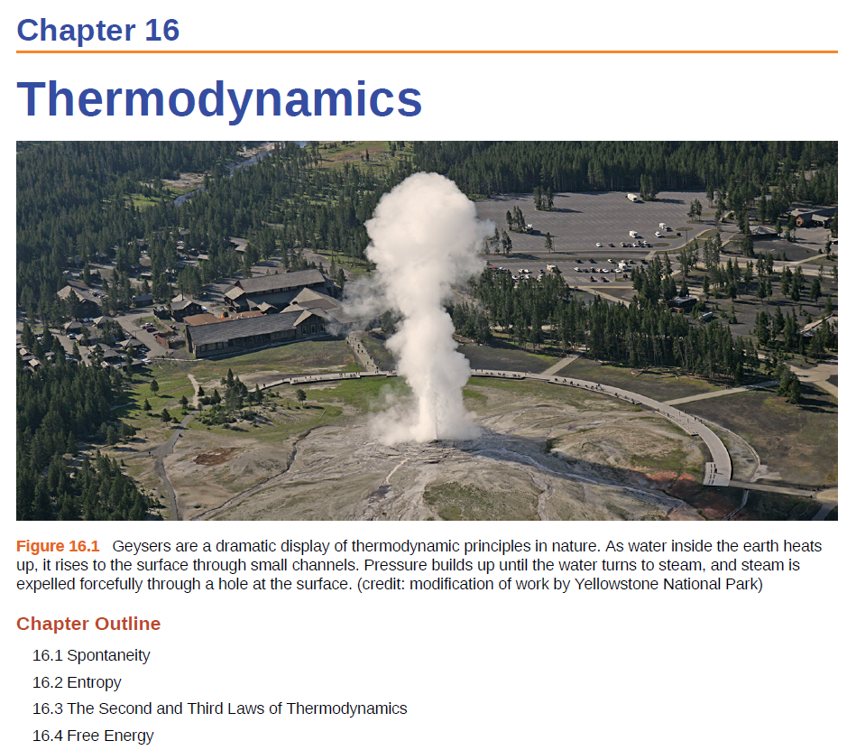

Slide 2
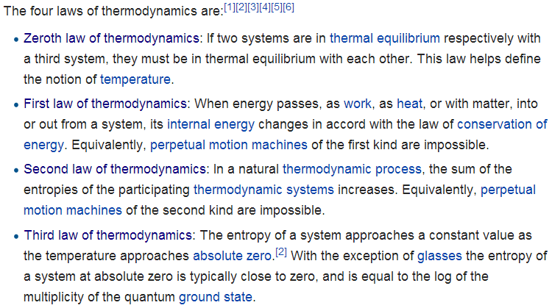
Laws of Thermodynamics
http://en.wikipedia.org/wiki/Laws_of_thermodynamics
Chapter 5
Chapter 16
Fourth law of thermodynamics: Emergent complexity?

Slide 3
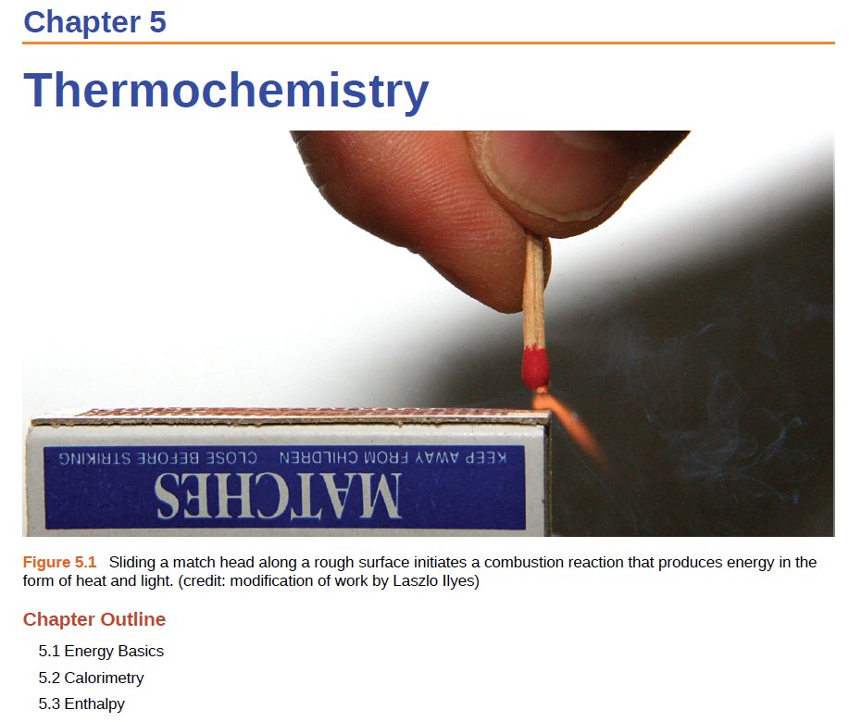

Slide 4
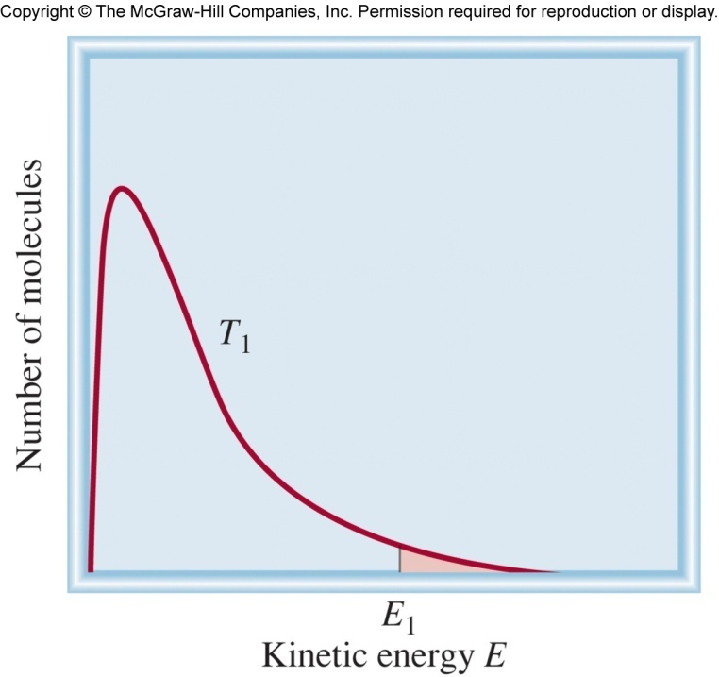
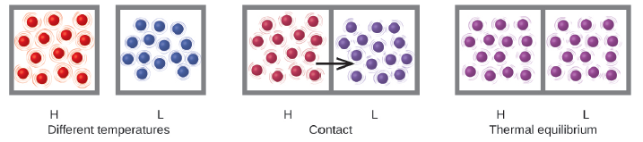
Chapter 5 Review
Energy is the capacity to supply heat or do work.
Potential Energy is the energy an object has because of its relative position, composition, or condition.
Kinetic Energy is the energy that an object possesses because of its motion.
Thermal energy is the kinetic energy associated with the the motion of atoms and molecules.
Temperature is the kinetic energy associated
with the motion of atoms and molecules.
“slow”
“fast”
Heat is the transfer of thermal energy between two bodies at different temperatures.

Slide 5
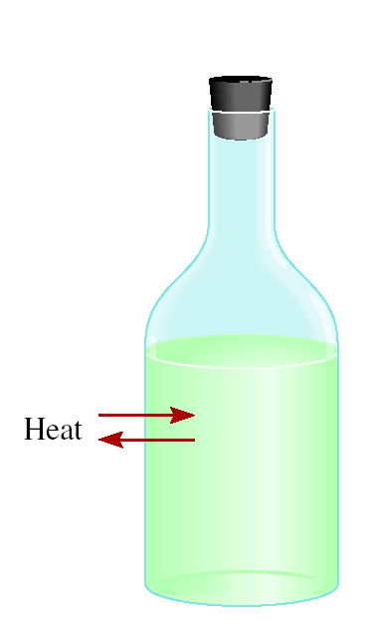
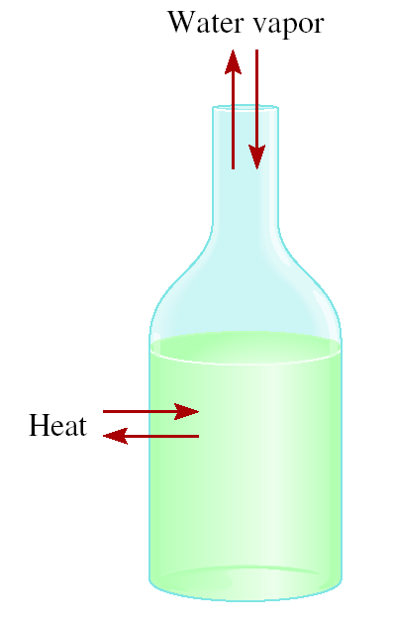
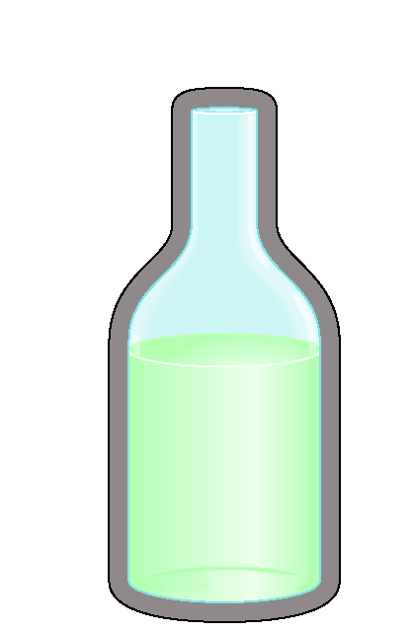
Chapter 5 Review
The system is the specific part of the universe that is of interest in the study.
surrounding
system
open
closed
isolated
Exchange:
mass & energy
energy
nothing

Slide 6
Chapter 5 Review
Exothermic process is any process that gives off heat – transfers thermal energy from the system to the surroundings.
2H₂ (g) + O₂ (g) 2H₂O (l) + energy
H₂O (g) H₂O (l) + energy
Endothermic process is any process in which heat has to be supplied to the system from the surroundings.
energy + 2H₂O (l) 2H₂ (g) + O₂ (g)
energy + H₂O (s) H₂O (l)

Slide 7
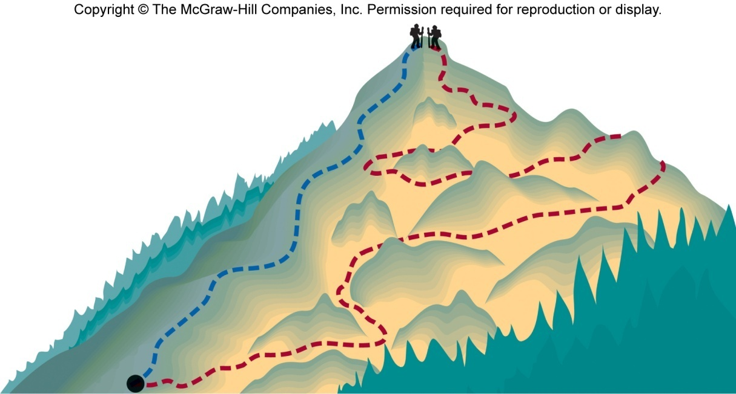
Chapter 5 Review
State of a system is the values of a set of measurable properties sufficient to determine all properties of a system.
State functions are properties that are determined by the state of the system, regardless of how that condition was achieved.
Potential energy of hiker 1 and hiker 2 is the same even though they took different paths.
State functions: temperature, pressure, volume, density, altitude, enthalpy, Gibbs free energy, and entropy.

Slide 8
Chapter 5 Review
First law of thermodynamics – energy can be converted from one form to another, but cannot be created or destroyed.
This law can be stated as, “The combined amount of energy in the universe is constant.”
The first law is also known as the Law of Conservation of Energy.
Energy is neither created nor destroyed in chemical reactions and physical changes.

Slide 9
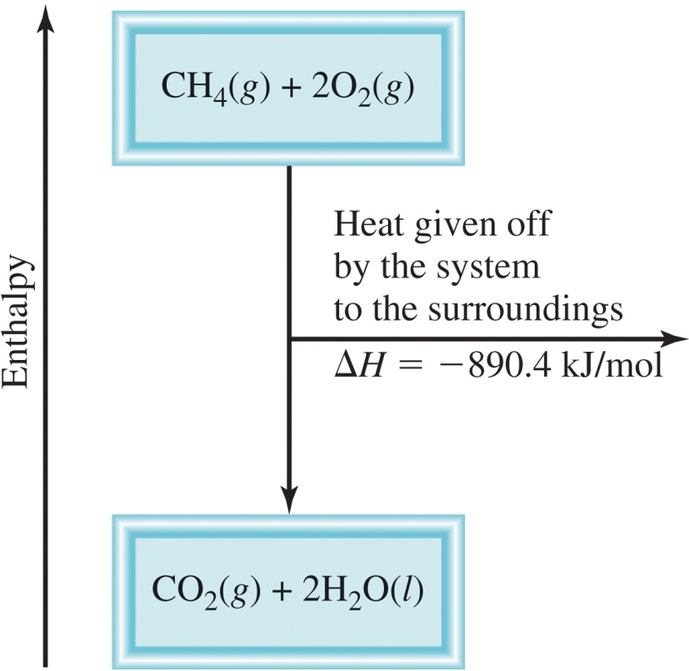
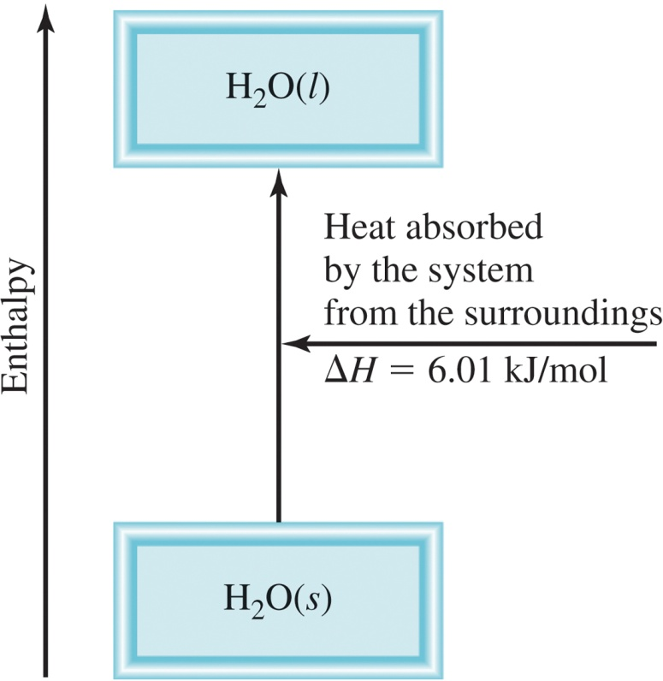
Chapter 5 Review
Enthalpy (H) is used to quantify the heat flow into or out of a system in a process that occurs at constant pressure.
ΔH_{rxn} = H_{products} – H_{reactants}
ΔH_{rxn} = heat given off or absorbed during a reaction at constant pressure
Exothermic
Endothermic
H_{products} < H_{reactants}
H_{products} > H_{reactants}
ΔH < 0
ΔH > 0

Slide 10
Chapter 5 Review
Thermochemical equations are a balanced chemical reaction and the ΔH value for the reaction.
For example, this is methane burning:
CH₄ (g) + 2O₂ (g) CO₂ (g) + 2H₂O (l)
ΔH = -890.4 kJ/mol
Experimentally Determined
ΔH_{rxn} = H_{products} – H_{reactants}
no way to measure the absolute value of the enthalpy of a substance
Establish an arbitrary scale with the standard enthalpy of formation (ΔH⁰) as a reference point for all enthalpy expressions.
f

Slide 11
Chapter 5 Review
Establish an arbitrary scale with the standard enthalpy of formation (ΔH⁰) as a reference point for all enthalpy expressions.
f
f
Standard enthalpy of formation (ΔH⁰) is the heat change that results when one mole of a compound is formed from its elements at a pressure of 1 atm.
f
I.e. set the standard enthalpy of formation of any element in its most stable form as zero.
ΔH⁰ (O₂) = 0
ΔH⁰ (C, graphite) = 0
f
f
ΔH⁰ (O₃) = 142 kJ/mol
ΔH⁰ (C, diamond) = 1.90 kJ/mol
f
f

Slide 12
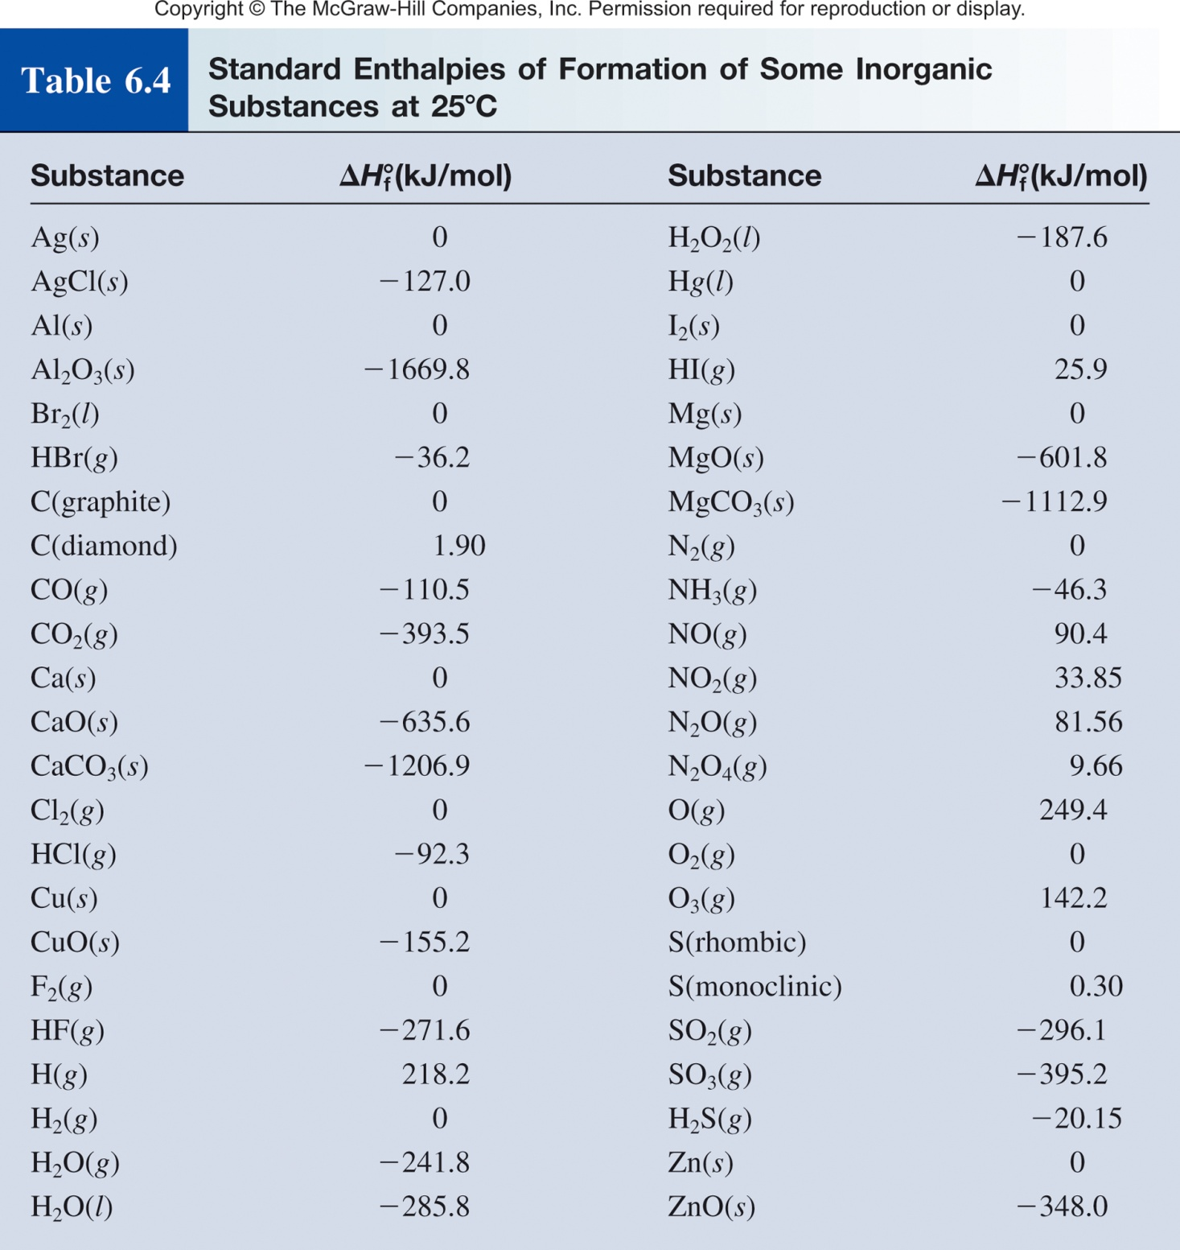
Chapter 5 Review
Standard enthalpy of formation (ΔH⁰) is the heat change that results when one mole of a compound is formed from its elements at a pressure of 1 atm.

Slide 13
Chapter 5 Review
The standard enthalpy of reaction (ΔH⁰ ) is the enthalpy of a reaction carried out at 1 atm.
rxn
aA + bB cC + dD
ΔH⁰
cΔH⁰ (C)
dΔH⁰ (D)
-
aΔH⁰(A)
bΔH⁰ (B)
=
[
+
]
[
+
]
rxn
f
f
f
f
ΔH⁰
=
Σ
nΔH⁰ (products)
-
Σ
mΔH⁰ (reactants)
rxn
f
f
Hess’s Law: When reactants are converted to products, the change in enthalpy is the same whether the reaction takes place in one step or in a series of steps.
(Enthalpy is a state function. It doesn’t matter how you get there, only where you start and end.)

Slide 14
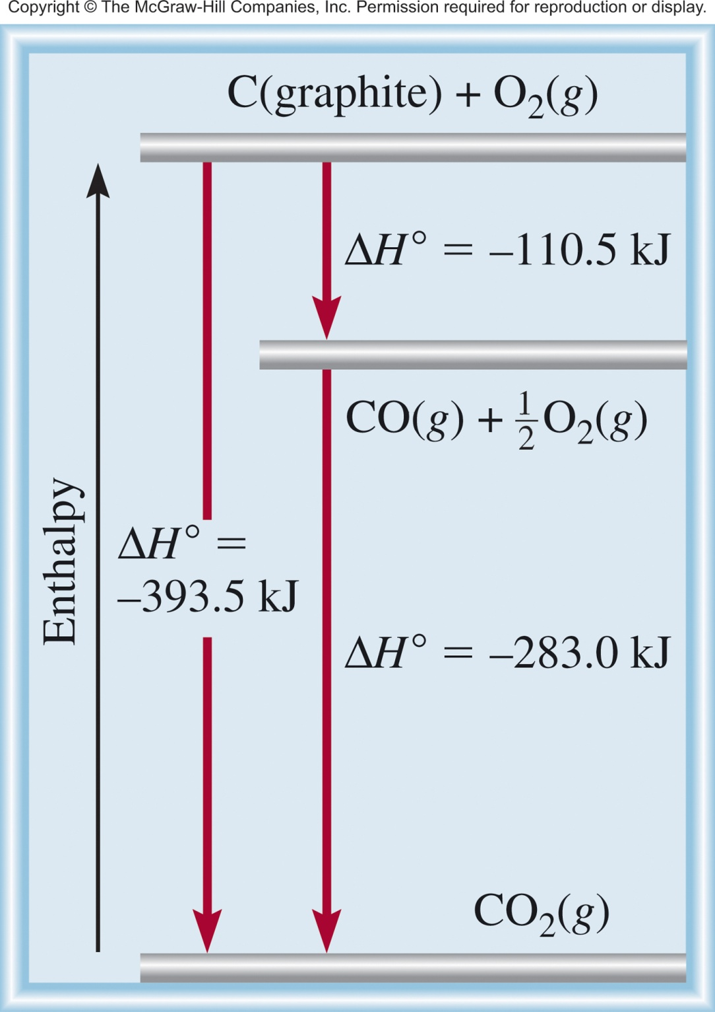
Chapter 5 Review
Direct Reaction
C (graphite) + O₂ (g) CO₂ (g)
Multistep Reaction
C (graphite) + 1/2O₂ (g) CO (g)
CO (g) + 1/2O₂ (g) CO₂ (g)
C (graphite) + O₂ (g) CO₂ (g)

Slide 15
Chapter 5 Review
Enthalpy (H) is used to quantify the heat flow into or out of a system in a process that occurs at constant pressure.
ΔH_{rxn} = H_{products} – H_{reactants}
H_{products} < H_{reactants}
H_{products} > H_{reactants}
ΔH < 0
ΔH > 0
Exothermic
Endothermic
Enthalpically favorable
Enthalpically unfavorable
If we mix reactants and products together will the reaction occur?
Not enough information. We need to know the change in entropy to predict if a reaction will spontaneously occur.

Slide 16


Slide 17
Laws of Thermodynamics
http://en.wikipedia.org/wiki/Laws_of_thermodynamics
Chapter 5
Chapter 16
Fourth law of thermodynamics: Emergent complexity?

Slide 19
Spontaneity
Does something happen?
Spontaneity- the tendency for a process to advance to equilibrium without external influence
Something that happens naturally is spontaneous
Any process will be spontaneous in one direction
The reverse is nonspontaneous
Spontaneous: process that does occur under a specific set of conditions
Nonspontaneous: process that does not occur under a specific set of conditions

Slide 20
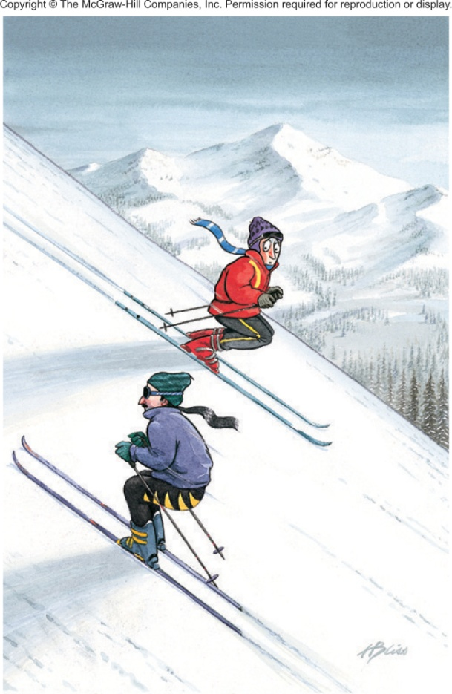
Spontaneity
A waterfall runs downhill
A lump of sugar dissolves in a cup of coffee
Smell diffusing in a room
Heat flows from a hotter object to a colder object
Iron exposed to oxygen and water forms rust
A ball rolling down hill
spontaneous
Processes that are spontaneous in one direction are nonspontaneous in the reverse direction.
nonspontaneous

Slide 21
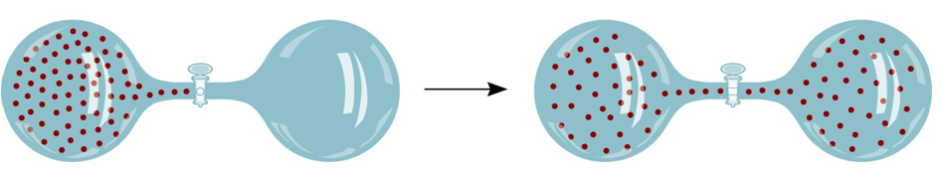

Spontaneity
spontaneous
nonspontaneous

Slide 22
Spontaneity
spontaneous
Diamonds are NOT forever!

Slide 23
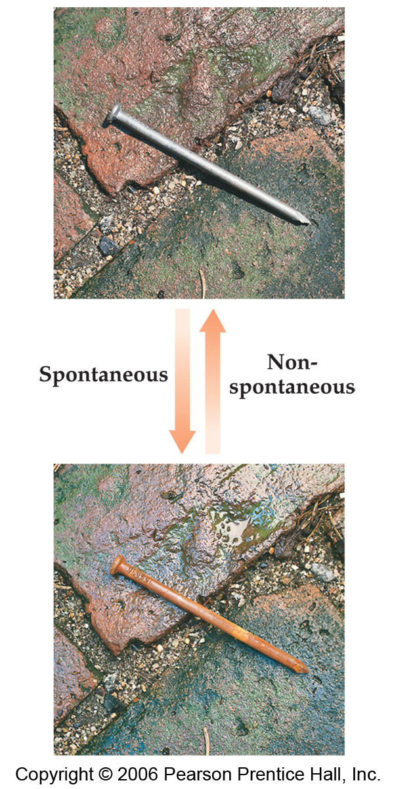
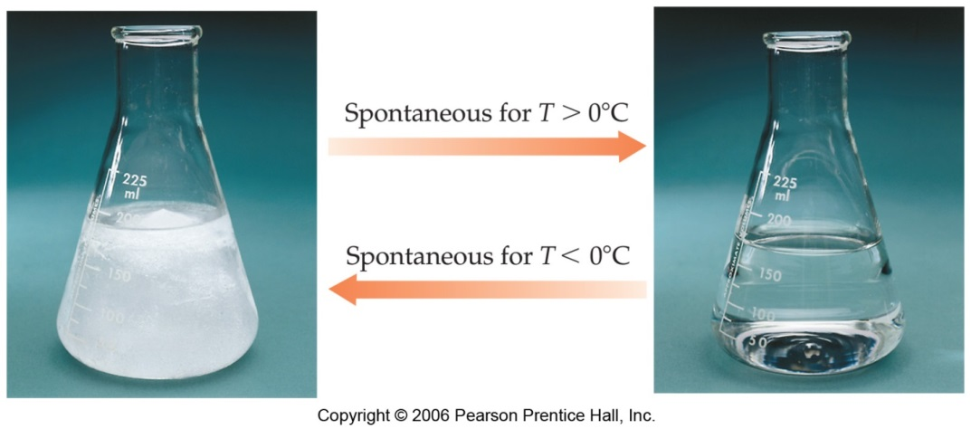
Spontaneity
Processes that are spontaneous at one temperature may be nonspontaneous at other temperatures.
Above 0°C it is spontaneous for ice to melt.
Below 0°C the reverse process is spontaneous.

Slide 24
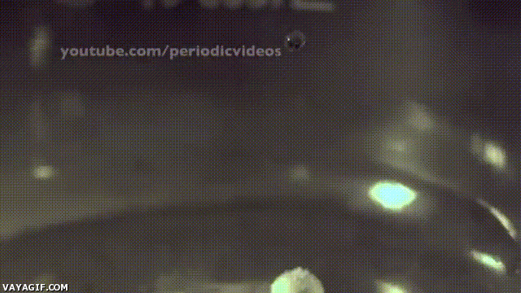
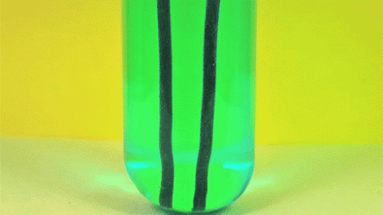
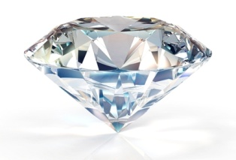

Spontaneity and Speed
The speed of a reaction is not an indicator of its spontaneity.
Spontaneity is determined by the relative positions of the initial and final states (thermodynamic state functions)
Additionally spontaneity does not tell you how fast a reaction is.
Speed is determined by the pathway (kinetics)
Two independent regimes (thermodynamics vs kinetics)
Fast spontaneous process
Slow spontaneous process
Very slow spontaneous process

Slide 25
Spontaneity and Exo/Endothermicity
Spontaneous: process that does occur under a specific set of conditions.
Nonspontaneous: process that does not occur under a specific set of conditions.
If we mix reactants and products together will the reaction occur?
CH₄ (g) + 2O₂ (g) CO₂ (g) + 2H₂O (l) ΔH⁰ = -890.4 kJ/mol
exothermic
H⁺ (aq) + OH⁻ (aq) H₂O (l) ΔH⁰ = -56.2 kJ/mol
H₂O (s) H₂O (l) ΔH⁰ = 6.01 kJ/mol
H₂O
endothermic
NH₄NO₃ (s) NH₄⁺(aq) + NO₃⁻ (aq) ΔH⁰ = 25 kJ/mol
Often spontaneous processes are exothermic, but not always….
Not enough information. We need to know the change enthalpy and in entropy to predict if a reaction will spontaneously occur.

Slide 27
Entropy
Entropy (S): Can be thought of as a measure of the randomness or disorder of a system.
order
S
disorder
S
- A measure of the loss of information in a transmitted message (Computer science/information theory).
A thermodynamic quantity representing the unavailability of a system's thermal energy for conversion into mechanical work.
A measure of how spread out or dispersed the energy of a system is among the different possible ways a system can contain energy.
- Is a measure of the number of specific ways (microstates) in which a thermodynamic system may be arranged.

Slide 28
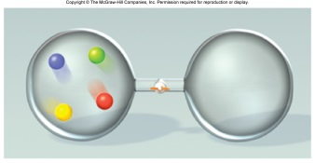
Microstates
Microstates- The detailed microscopic configuration of a system.
How many different ways can a system be arranged.
Red, blue, green and yellow spheres in a two compartment container.

Slide 29
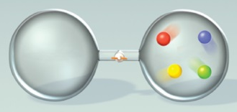
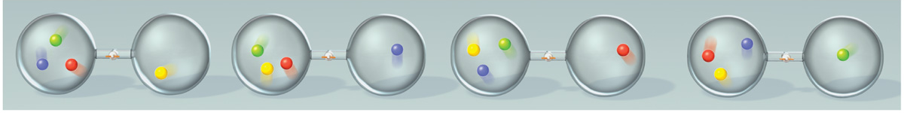
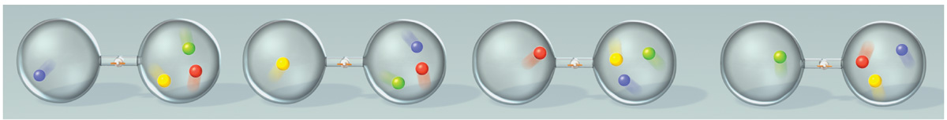
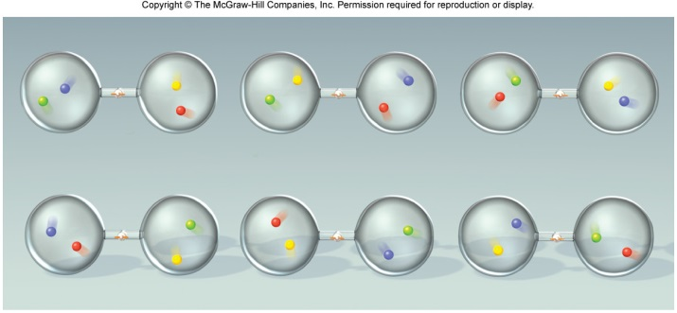
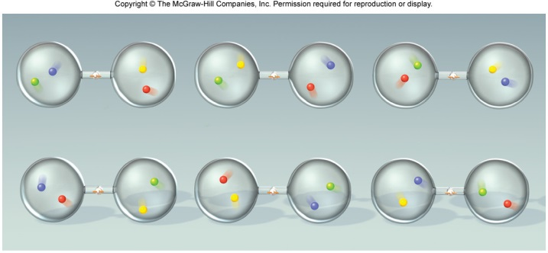
Microstates
Microstates- The detailed microscopic configuration of a system.
How many different ways can a system be arranged.
Red, blue, green and yellow spheres in a two compartment container.
Total microstates = 22
4 and 0 = 2 microstates
3 and 1 = 8 microstates
2 and 2 = 12 microstates

Slide 30


Microstates and Entropy
4 and 0 = 2 microstates
More order, Less entropy
3 and 1 = 8 microstates
2 and 2 = 12 microstates
Less order, more entropy
Configurations (macrostates) associated with large numbers of microstates are said to be more disordered than those with fewer microstates.
The equilibrium state of a system is the most disordered configuration (largest no. of microstates) available.
The number of microstates is called the multiplicity (W) of the configuration.

Slide 31
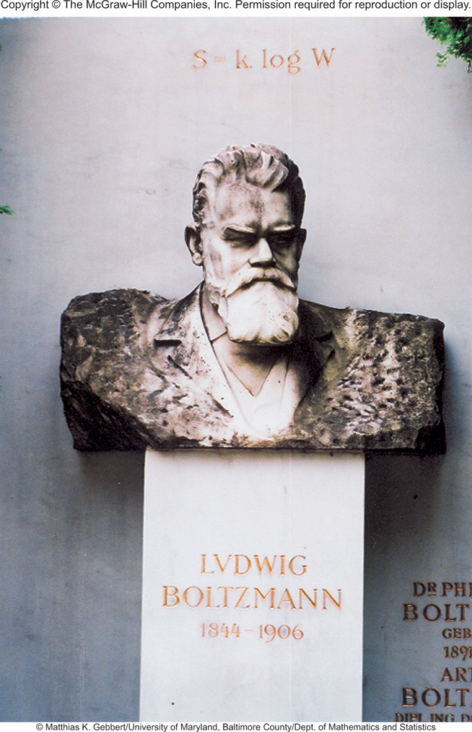
Microstates and Entropy
The Austrian physicist Ludwig Boltzmann introduced a model to relate the total number of microstates (the multiplicity, W) to entropy (S).
Boltzmann constant (k)
S = k ln W
k = 1.38 x 10⁻²³J/K
Gas constant
units on S is J/K
Avogadro constant
Boltzmann was the founding father of statistical mechanics, a completely new way of thinking about theoretical physics. His work was ridiculed by his fellow professors.

Slide 32
Microstates and Entropy
S = k ln W
k = 1.38 x 10⁻²³J/K
4 and 0 = 2 microstates
S = 9.6 x 10⁻²⁵ J/K
More order, Less entropy
3 and 1 = 8 microstates
S = 2.9 x 10⁻²⁴ J/K
2 and 2 = 12 microstates
S = 3.4 x 10⁻²⁴ J/K
Less order, more entropy
has > than 3 times as much entropy as

Slide 33
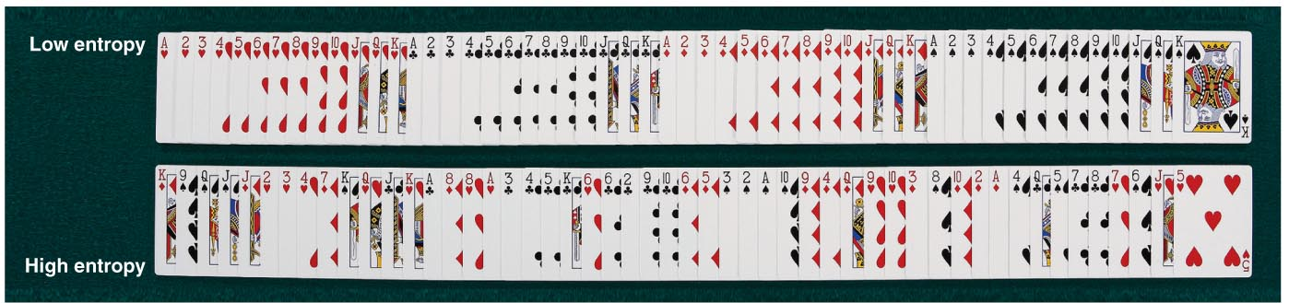
Entropy and Cards
Ordered Deck
W = 1
Unordered Deck
W = (52!) - 1
W = 80658175170943878571660636856403766975289505440883277823999999999999

Slide 34







Entropy and Cards
High card
Flush
Full house
Royal Flush
A pair
Three of a kind
Poker: The game that rewards lowest entropy!

Slide 35
Entropy and Cards
Hand | W
Royal flush (AKQJ10 in one suit) | 4
Straight flush (sequence in one suit) | 36
Four of a kind | 624
Full house (three of a kind plus a pair) | 3,744
Flush (five cards in the same suit) | 5,108
Straight (five cards in sequence) | 10,200
Three of a kind | 54,912
Two pairs | 123,552
One pair | 1,098,240
No pairs | 1,302,540
Total | 2,598,960
ln W | S (J/K)
1.39 | 1.92 x 10⁻²³
3.58 | 4.94 x 10⁻²³
6.44 | 8.89 x 10⁻²³
8.23 | 1.14 x 10⁻²²
8.54 | 1.18 x 10⁻²²
9.23 | 1.27 x 10⁻²²
10.91 | 1.51 x 10⁻²²
11.72 | 1.62 x 10⁻²²
13.91 | 1.92 x 10⁻²²
14.08 | 1.94 x 10⁻²²
Poker: The game that rewards the player with the hand that has the least entropy.
Table does not account for high card (the equivalent of enthalpy?).

Slide 36
Entropy and Reactions
“All” chemical and physical changes involve a change in entropy (ΔS) for the system.
A + B C + D
ΔS = S_{f} - S_{i}
S_{initial}
S_{final}
If the change from initial to final results in an increase in randomness and number of states.
S_{f} > S_{i}
ΔS > 0
ΔS = S_{f} - S_{i}
S = k ln W
W_{f} > W_{i} then ΔS > 0
ΔS = k ln W _{f} - k ln W _{i}
W_{f} < W_{i} then ΔS < 0
W_{f}
ΔS = k ln
W_{i}

Slide 37
Entropy and Reactions
“All” chemical and physical changes involve a change in entropy (ΔS) for the system.
A + B C + D
ΔS = S_{f} - S_{i}
S_{initial}
S_{final}
General Molecular Trends:
Structure (gas vs solid, etc.)
less structure =more states = more entropy
Temperature
higher temp = more energy states = more entropy
Number of particles/atoms
more particles = more states = more entropy

Slide 38
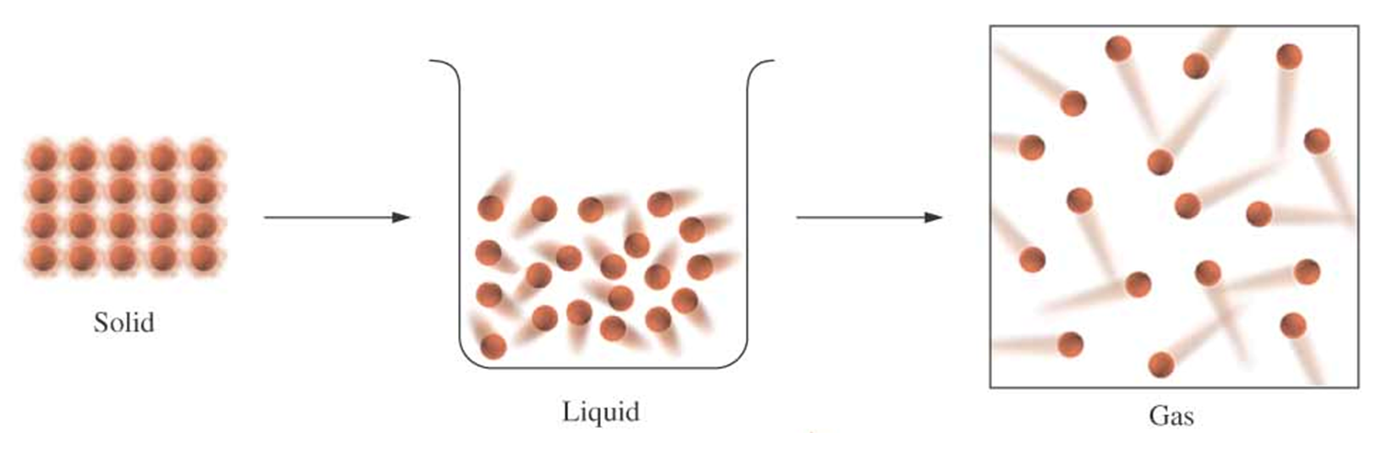
1) Structure/Phase
Increasing disorder
Increasing entropy (S)
For any substance, the solid state is more ordered than the liquid state and the liquid state is more ordered than gas state.
When a gas expands into a vacuum, its entropy increases because the increased volume allows for greater atomic or molecular disorder.
S_{solid} < S_{liquid} << S_{gas}

Slide 39
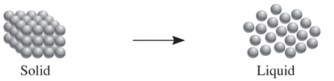
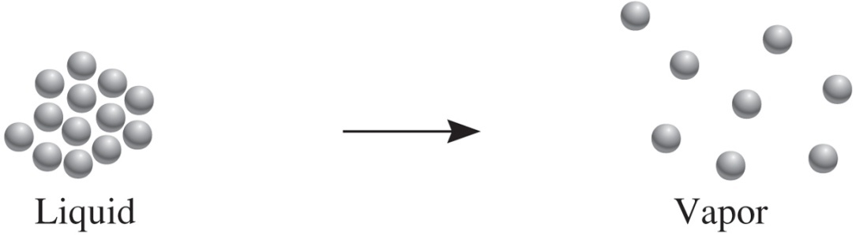
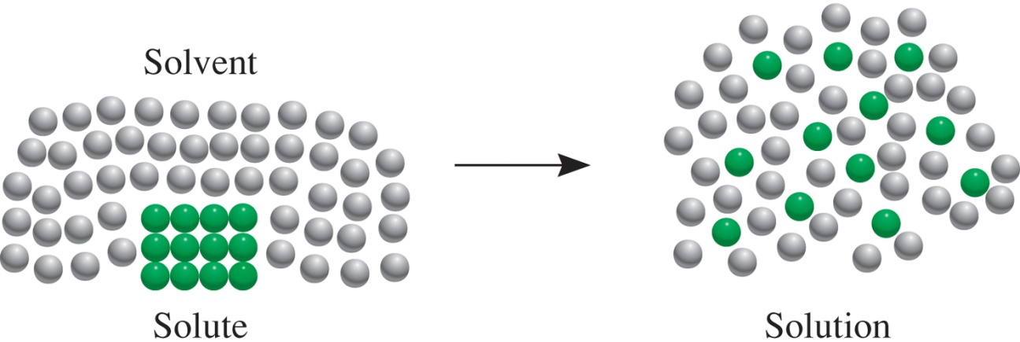
Structure/Phase
Processes that lead to an increase in entropy (ΔS > 0)

Slide 40
Entropy and Reactions
“All” chemical and physical changes involve a change in entropy (ΔS) for the system.
A + B C + D
ΔS = S_{f} - S_{i}
S_{initial}
S_{final}
General Molecular Trends:
Structure/Phase (gas vs solid, etc.)
less structure =more states = more entropy
Temperature
higher temp = more energy states = more entropy
Number of particles/atoms
more particles = more states = more entropy

Slide 41
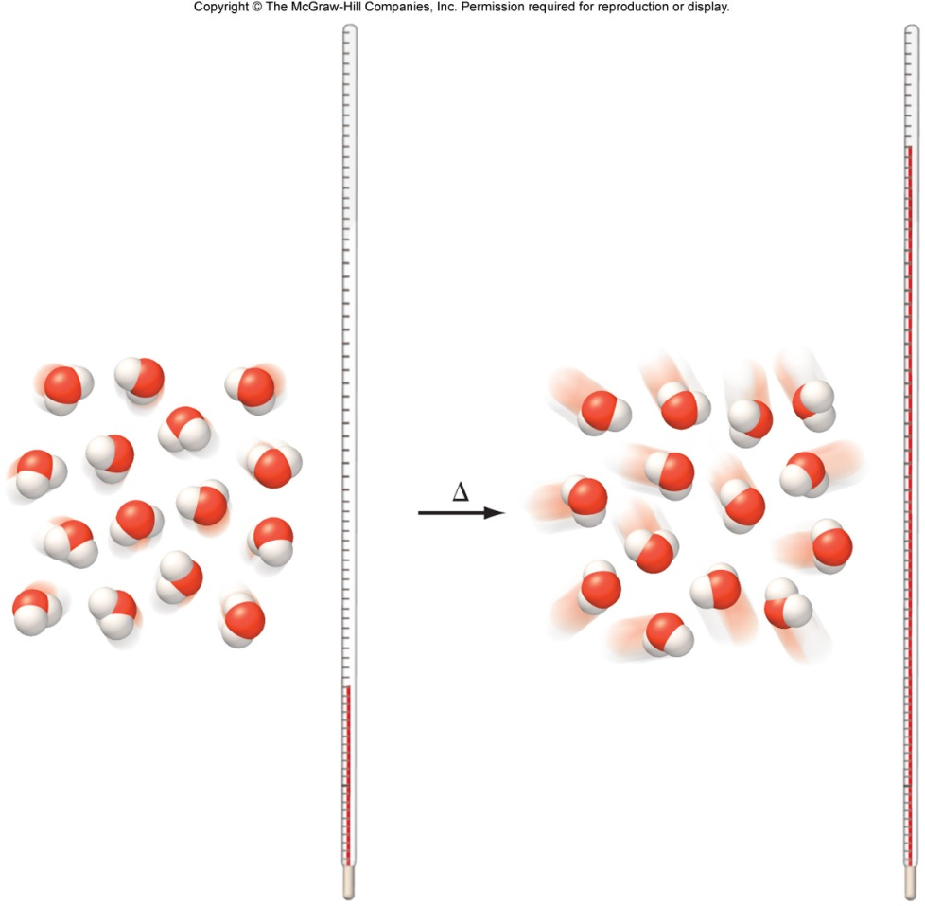
Entropy and Temperature
Entropy increases as temperature increases.
S_{lower temp} < S_{higher temp}
Higher temperature allows the system to access more microstates.

Slide 42
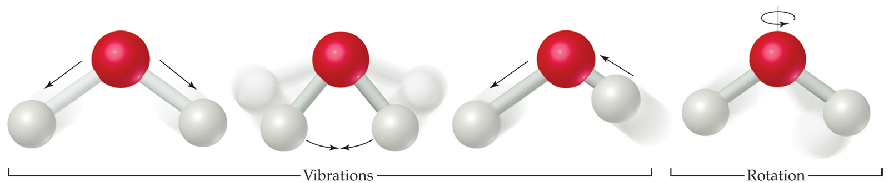
Entropy and Temperature
Molecules exhibit several types of motion:
Translational: Movement of the entire molecule from one place to another.
Vibrational: Periodic motion of atoms within a molecule.
Rotational: Rotation of the molecule on about an axis or rotation about σ bonds.
Higher temperature allows the system to access more vibrational and rotational states (increases microstates).
Notes:
€

Slide 43
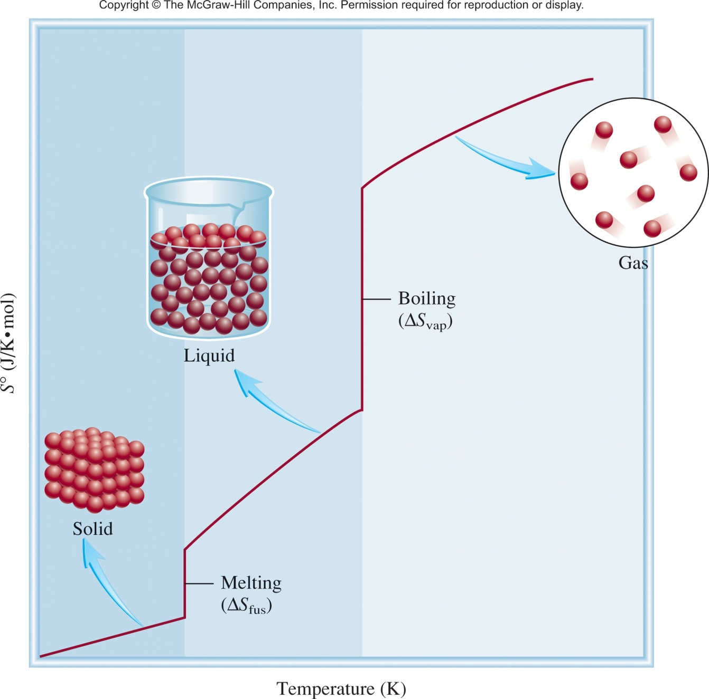
Temperature and Phase Change
S increases slightly with T
S increases a large amount with phase changes

Slide 44
Entropy and Reactions
“All” chemical and physical changes involve a change in entropy (ΔS) for the system.
A + B C + D
ΔS = S_{f} - S_{i}
S_{initial}
S_{final}
General Molecular Trends:
Structure/Phase (gas vs solid, etc.)
less structure =more states = more entropy
Temperature
higher temp = more energy states = more entropy
Number of particles/atoms
more particles = more states = more entropy

Slide 45
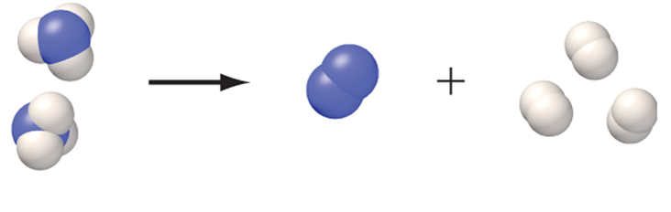

Number of Atoms/Particles
More particles leads to a greater number of microstates (greater S).
2 molecules
4 molecules
S_{fewer moles} < S_{more moles}

Slide 46
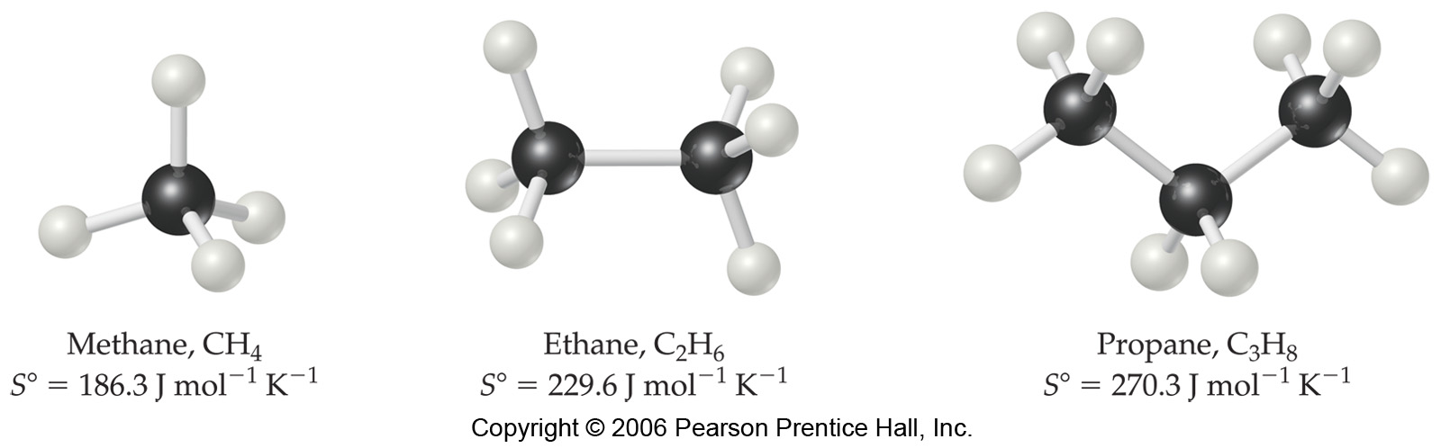
Number of Atoms/Particles
Larger and more complex molecules have greater entropies.
5 atoms
8 atoms
11 atoms
More atoms = more vibrational and rotational states
S_{fewer atoms} < S_{more atoms}

Slide 47
Entropy and Reactions
“All” chemical and physical changes involve a change in entropy (ΔS) for the system.
A + B C + D
ΔS = S_{f} - S_{i}
S_{initial}
S_{final}
General Molecular Trends:
Structure/Phase (gas vs solid, etc.)
less structure =more states = more entropy
Temperature
higher temp = more energy states = more entropy
Number of particles/atoms
more particles = more states = more entropy

Slide 48
Entropy decrease = -ΔS
Entropy increase = +ΔS
Question:
Predict whether the entropy change is greater or less than zero for each of the following processes:
1) EtOH(l) → EtOH(s)
2) cooling nitrogen gas from 80°C to 20°C
3) dissolving glucose in water
4) 2C₆H₆ (l) + 15O₂ (g) ⟶ 12CO₂(g) + 6H₂O(l)
A) ΔS > 0 B) ΔS < 0 C) ΔS = 0
A) ΔS > 0 B) ΔS < 0 C) ΔS = 0
A) ΔS > 0 B) ΔS < 0 C) ΔS = 0
A) ΔS > 0 B) ΔS < 0 C) ΔS = 0

Slide 49
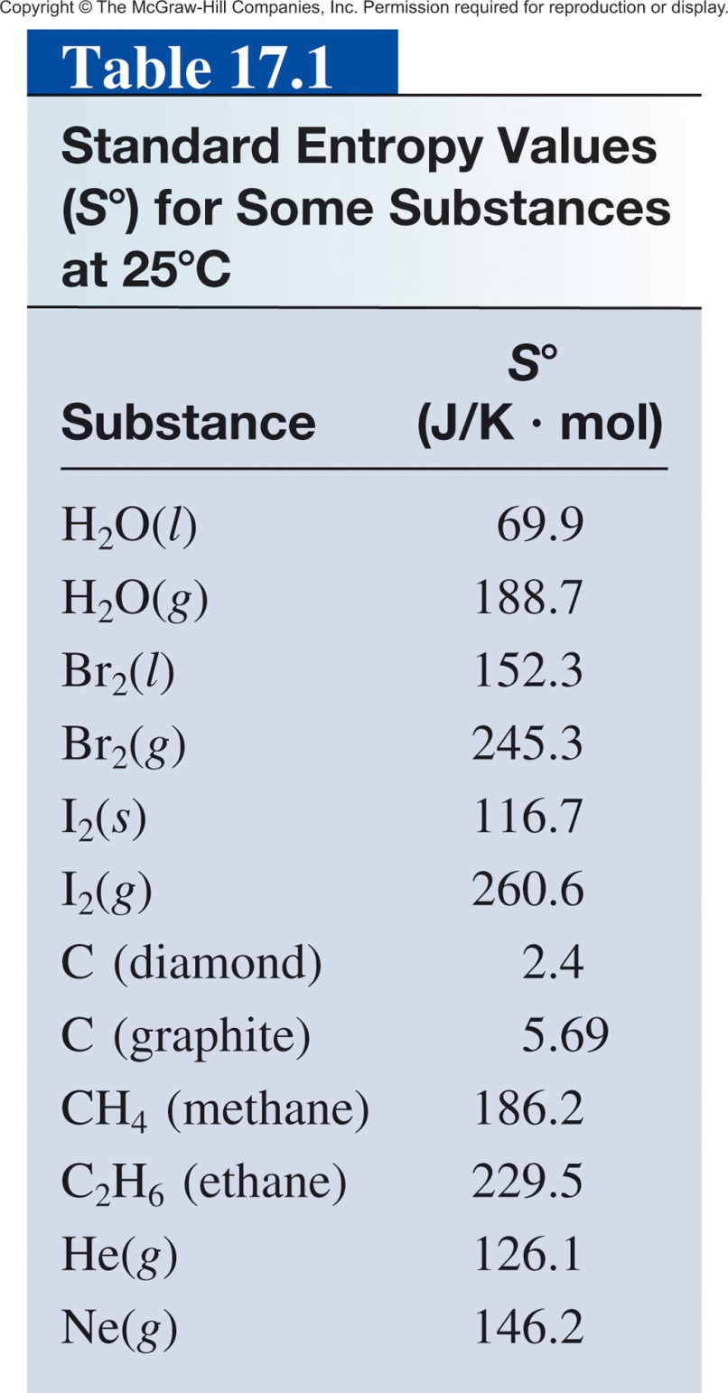
Standard Entropy
Difficult to count the number of microstates directly.
Measured by calorimetery.
Standard entropy (S°) absolute entropy of a substance at 1 atm (typically at 25°C)
Units of J K⁻¹ mol⁻¹
All positive values.
Absolute values (unlike ΔH which is relative)

Slide 50
Standard Entropy
Entropy for gas phase is greater than that of liquid or solid of same substance
I₂ (g) > I₂ (s)
More complex structures have greater entropy
C₂H₆ (g) > CH₄ (g)
Allotropes - more ordered forms have lower entropy
Diamond < graphite
Can be used to calculate ΔS_{rxn} and ΔS_{sys}.

Slide 52
Thermodynamics
First Law of Thermodynamics
Energy can be converted from one form to another but energy cannot be created or destroyed.
Second Law of Thermodynamics
The entropy of the universe increases in a spontaneous process and remains unchanged in an equilibrium process.
ΔS_{univ} = ΔS_{sys} + ΔS_{surr}
Spontaneous process:
ΔS_{univ} > 0
surrounding
Equilibrium :
ΔS_{univ} = 0
system
Nonspontaneous process:
ΔS_{univ} < 0
If something happens the total entropy of the universe increases.

Slide 53
Thermodynamics
For chemical reactions our system is the reaction and
ΔS_{sys} is ΔS⁰_{rxn}
The standard entropy of reaction (ΔS⁰ ) is the entropy change for a reaction carried out at 1 atm and 25⁰C.
rxn
surrounding
system
aA + bB cC + dD
Standard Entropy of Reaction (ΔS⁰_{rxn})- The difference between the sum of the entropies of the products and the sum of the entropies of the reactants:
ΔS⁰
=
Σ
nS⁰(products)
-
Σ
mS⁰(reactants)
rxn
ΔS⁰
-
[
aS⁰(A)
+
bS⁰(B)
=
[
cS⁰(C)
+
dS⁰(D)
]
]
rxn

Slide 54
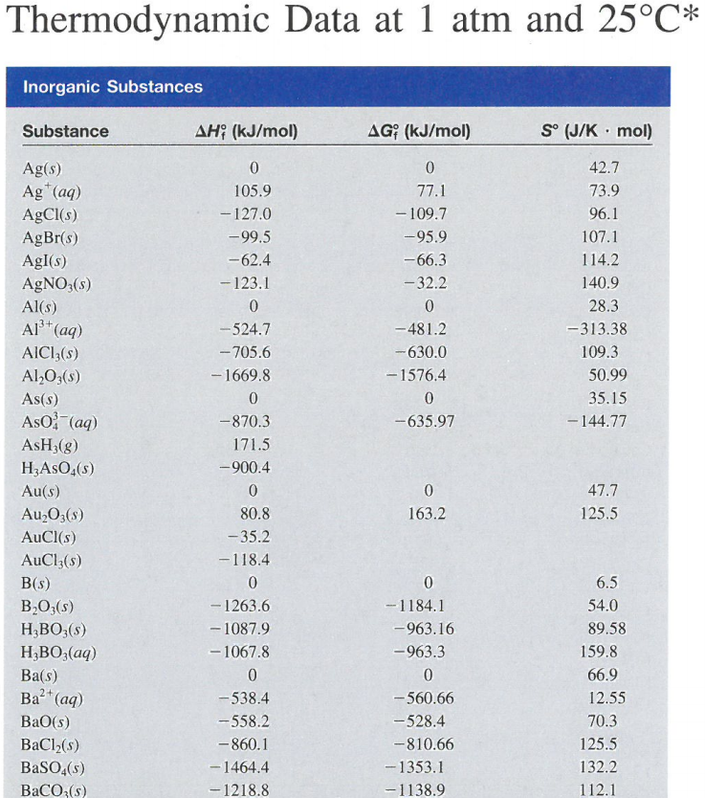
Calculating Entropy for a Reaction
aA + bB cC + dD
ΔS⁰
=
[
cS⁰(C)
+
dS⁰(D)
]
rxn
[
aS⁰(A)
+
bS⁰(B)
-
]
What is the ΔS⁰_{rxn} for:
2H₂(g) + O₂(g) → 2H₂O (l)
First, qualitatively predict the entropy change:
Increase, decrease or none

Slide 55
Entropy for a Reaction
From appendix 3:
H₂(g) S° = 131.0 J/Kmol
O₂(g) S° = 205.0 J/Kmol
H₂O(l) S° = 69.9 J/Kmol
2H₂(g) + 1O₂(g) → 2H₂O (l)
ΔS°_{rxn} = ΣnΔS°_{products} − ΣmΔS°_{reactants}
ΔS°_{rxn} = [(2)(69.9 J/K·mol)] - [(2)(131.0 J/K·mol) + (1)(205.0 J/K·mol)]

Slide 56
Entropy for a Reaction
From appendix 3:
H₂(g) S° = 131.0 J/Kmol
O₂(g) S° = 205.0 J/Kmol
H₂O(l) S° = 69.9 J/Kmol
2H₂(g) + 1O₂(g) → 2H₂O (l)
ΔS°_{rxn} = ΣnΔS°_{products} − ΣmΔS°_{reactants}
ΔS°_{rxn} = [(2)(69.9 J/K·mol)] - [(2)(131.0 J/K·mol) + (1)(205.0 J/K·mol)]
ΔS°_{rxn} = -327.2 J/K·mol
Entropy Decreases!

Slide 57
Entropy for a Reaction
2H₂(g) + O₂(g) → 2H₂O (l)
ΔS°_{rxn} = -327.2 J/K·mol
2H₂(g) + O₂(g) → 2H₂O (g)
ΔS°_{rxn} = ?
Greater than or less than - 327.2 J/K·mol ?
ΔS°_{rxn} = [(2)(188.7 J/K·mol)] - [(2)(131.0 J/K·mol) + (1)(205.0 J/K·mol)]
ΔS°_{rxn} = -89.6 J/K·mol
Entropy Decreases!
From appendix 3:
but by less:
H₂(g) S° = 131.0 J/Kmol
O₂(g) S° = 205.0 J/Kmol
H₂O(l) S° = 69.9 J/Kmol
H₂O(g) S° = 188.7 J/Kmol
2H₂O (l) → 2H₂O (g)
ΔS°_{rxn} = 237.6 J/K·mol

Slide 58
3 Laws of Thermodynamics
First Law of Thermodynamics
Energy can be converted from one form to another but energy cannot be created or destroyed.
Second Law of Thermodynamics
The entropy of the universe increases in a spontaneous process and remains unchanged in an equilibrium process.
Third Law of Thermodynamics
The entropy of a pure crystalline substance at 0 K is zero.

Slide 59
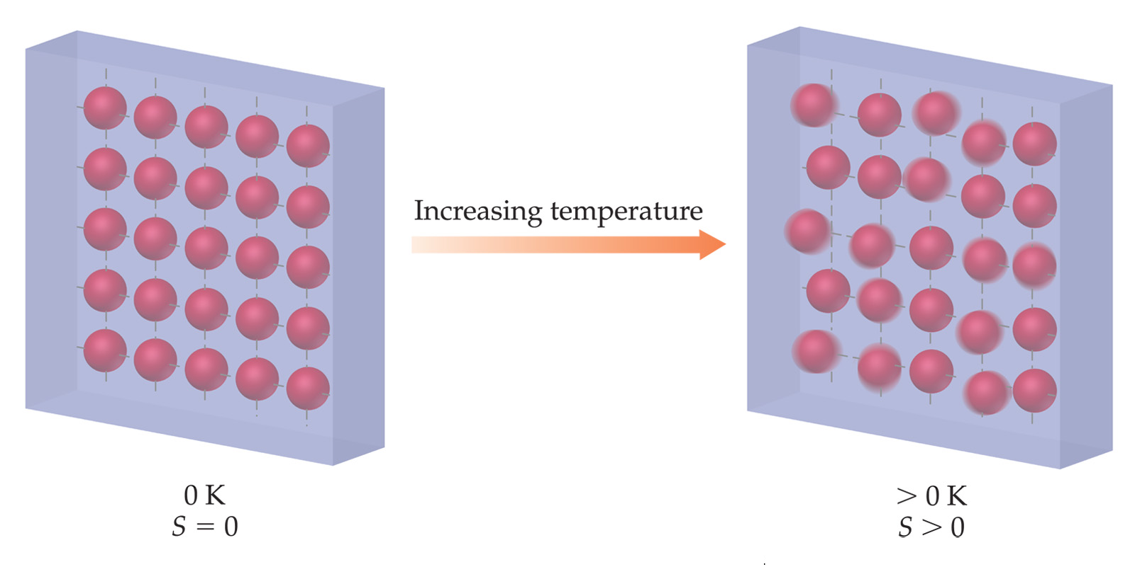
3rd Law of Thermodynamics
Third Law of Thermodynamics
The entropy of a pure crystalline substance at absolute zero is 0.
Only 1 possible microstate!
This is the why we have an “absolute” entropy scale for substances.

Slide 60
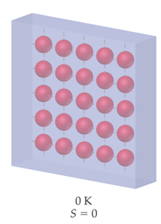

3rd Law of Thermodynamics
Real Crystals
Experimentally we “can’t” get down to 0 K (absolute zero).
Absolute zero cannot be reached using only thermodynamic means, as the temperature of the substance being cooled approaches the temperature of the cooling agent asymptotically.
In September 2014, scientists in the CUORE collaboration cooled a copper vessel with a volume of one cubic meter to 0.006 K (−273.144 °C; −459.659 °F) for 15 days.

Slide 61
3rd Law of Thermodynamics
S = k ln W
W = 1
S = 0

Slide 62
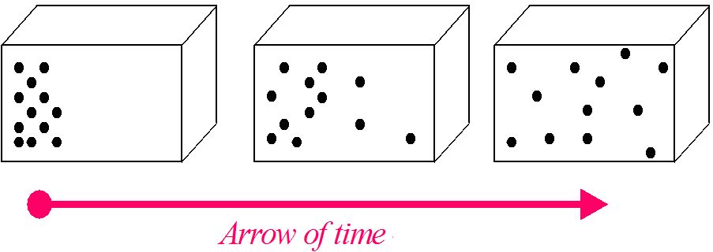
Side Note: Entropy and Time
Entropy is the only quantity in the physical sciences (apart from certain rare interactions in particle physics) that requires a particular direction for time, sometimes called an arrow of time.
Lower Entropy
Higher Entropy
As one goes "forward" in time, the second law of thermodynamics says, the entropy of an isolated system can increase, but not decrease.

